Slide 1
Math 351
Numerical Analysis
E. Agyeman

Slide 2
Introduction
Physical phenomenon in Science and Engineering converted into mathematical models usually lead to problems with no analytical solutions.
Numerical Methods is the study, development and analysis of procedures/algorithms for solving problems with no analytical solutions using computers.
The main objective of this course is to equip students with the tools and skills to solve mathematical problems in Engineering/Science with no analytical solutions.
Notes:
4

Slide 3
Introduction
There are three central concepts in the analysis of Numerical Techniques:
convergence: whether the method approximates the solution,
order: how well it approximates the solution, and
stability: whether errors are damped out.
Notes:
4

Slide 4
Objectives
The course is presented into four units:
Unit 1: Numerical Solutions of Linear Systems using Direct and Iterative Techniques. Solution of Specil Systems:Positive Definite and Tridiagonal systems.
Unit 2: Vector and Matrix Norms; Determinants and Inverses. Determination of Eigenvalues and Eigenvectors; Characteristic Equation Approach and Iterative Techniques.
Unit 3: Interpolation Techniques. Numerical Techniques for Solving Non-Linear Systems.
Unit 4: Numerical Differentiation amd Integration. Numerical Solutions Ordinary Differentiation.
Notes:
2

Slide 5
Unit 1

Slide 6
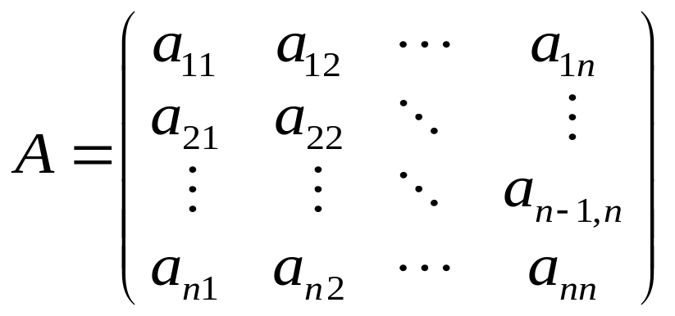
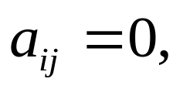


System of Linear Equations
Consider an nxn Matrix A
The Matrix A is said to be a lower or upper triangular matrix if or respectively.

Slide 7
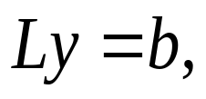
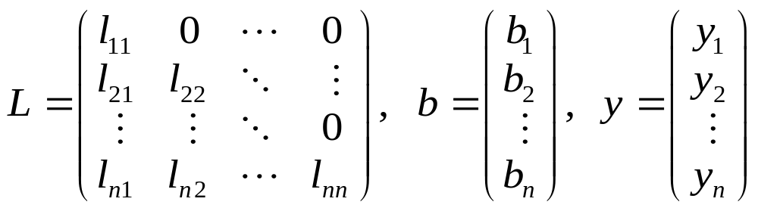
Solutions of Triangular Systems
Consider the Lower Triangular Systems:
where

Slide 8
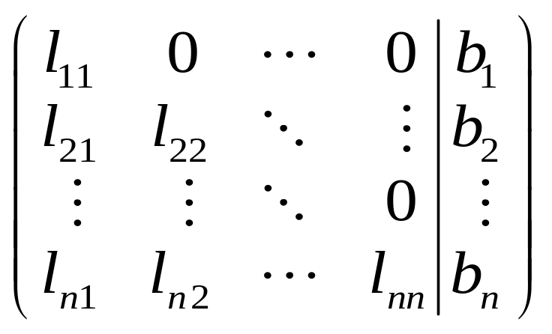
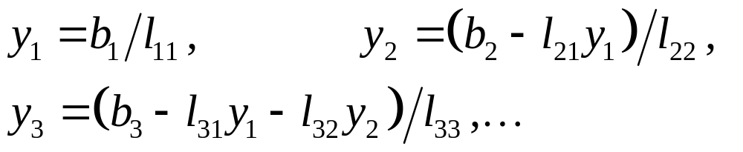
Solutions of Triangular Systems
Writing the above in augmented form, we have
and can be solved as follows:

Slide 9

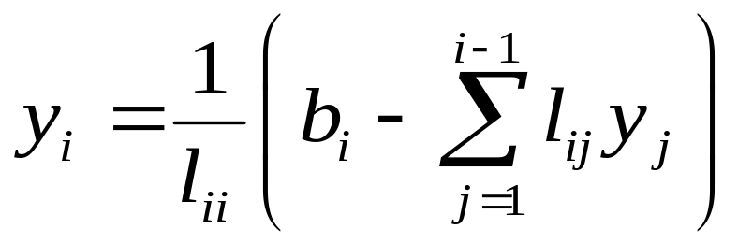
Solutions of Triangular Systems
The above shows that an algorithm can be developed to solve systems of such forms, hence the forward substitution algorithm. The algorithm is so named since y₁ is solved first followed by y₂ etc. Below is the Forward Substitution Algorithm:
For
do

Slide 10

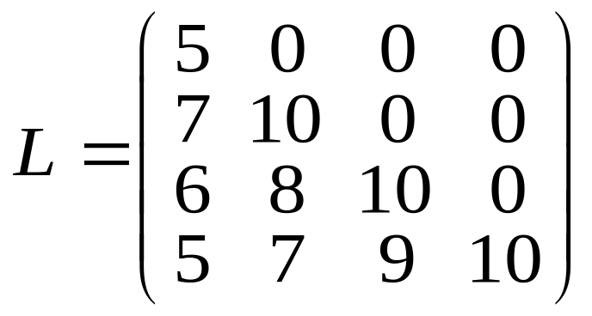
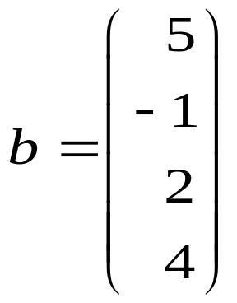
Example 1 (Lower triangular system)
Solve the following lower triangular system,
where
and

Slide 11
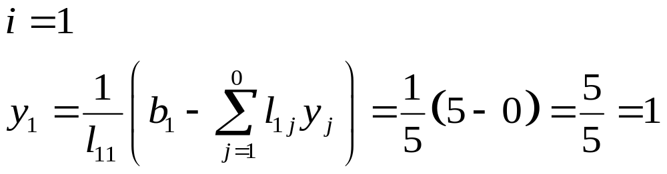
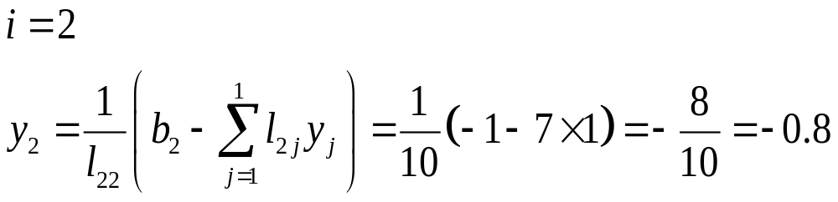
Solution 1: (Lower triangular system)

Slide 12
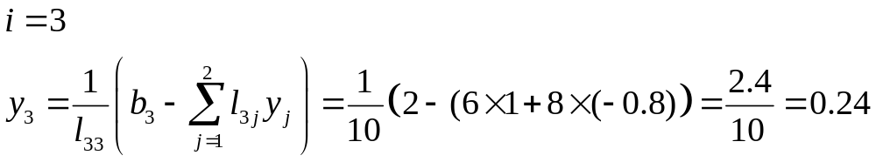

Solution 1 (Lower triangular system)

Slide 13
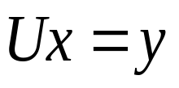
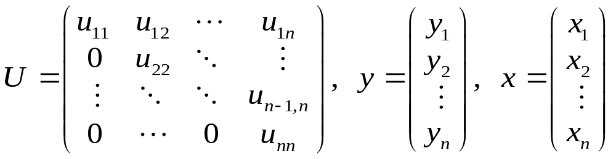
Solutions of Triangular Systems
Consider the Upper Triangular Systems:
where

Slide 14
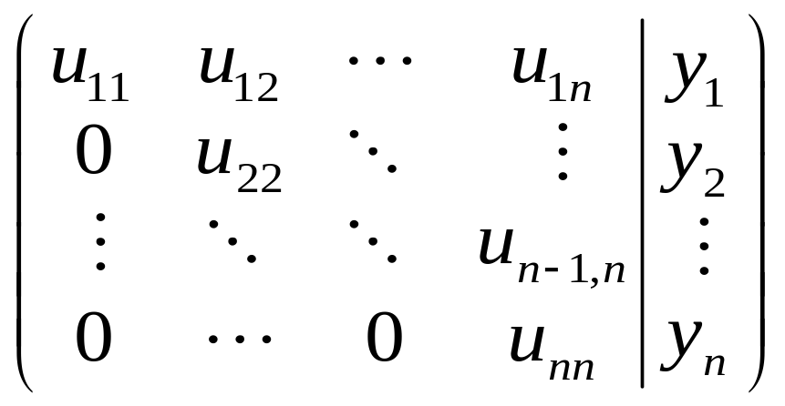
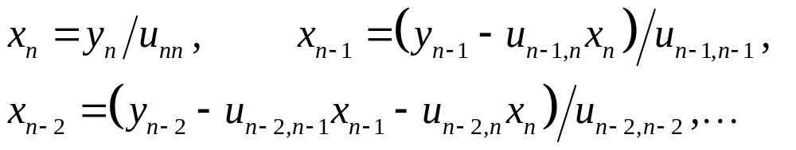
Solutions of Triangular Systems
Writing the above in augmented form, we have
and can be solved as follows:

Slide 15

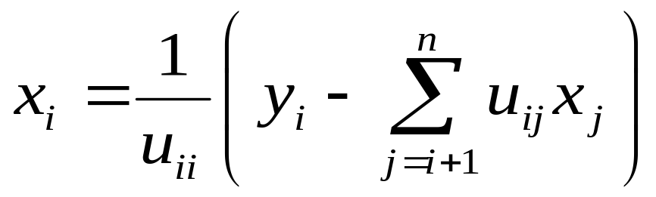
Solutions of Triangular Systems
The above shows that an algorithm can be developed to solve systems of such forms, hence the back substitution algorithm. The algorithm is so named since x_{n} is solved first followed by x_{n-1} etc. Below is the Back Substitution Algorithm:
For
do

Slide 16

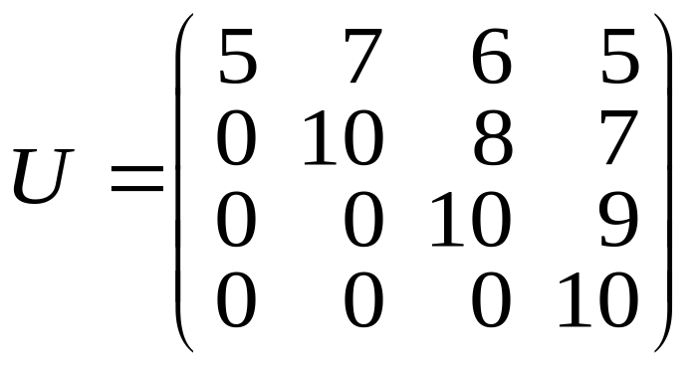
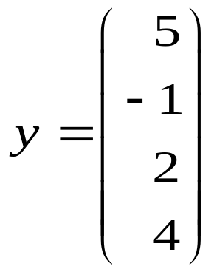
Example 2 (Upper triangular system)
Solve the following upper triangular system,
where
and

Slide 17
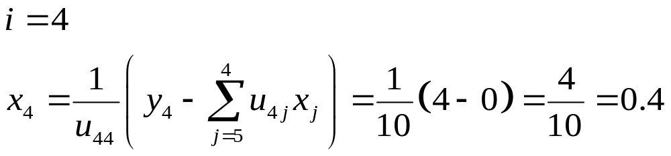
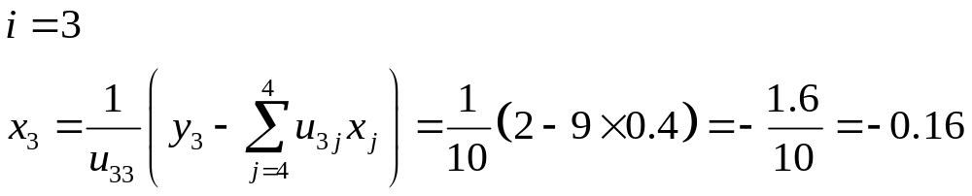
Solution 2 (Upper triangular system)

Slide 18
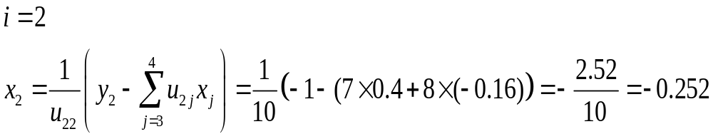
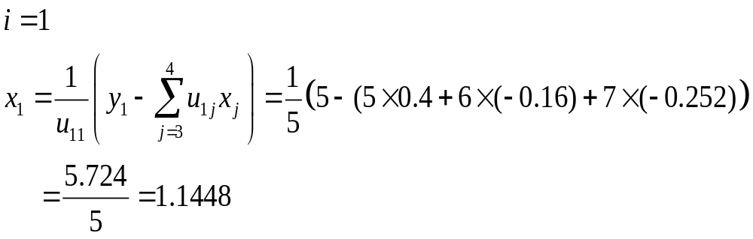
Solution 2 (Upper triangular system)

Slide 19
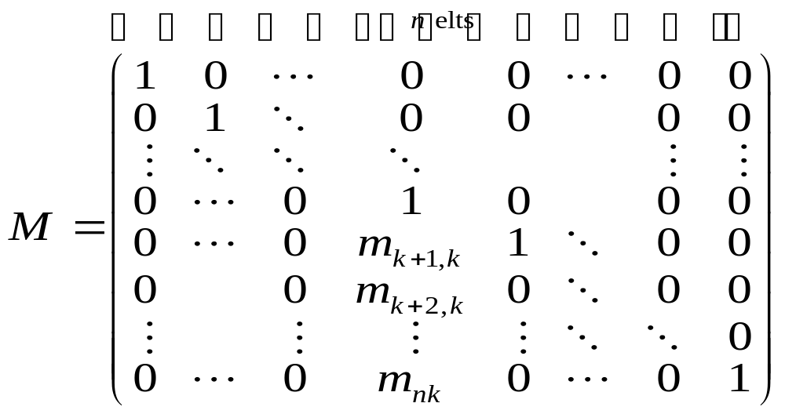
Definitions: (Permutation/Elementary) Matrices
A nonzero matrix P is a Permutation matrix if there is exactly one nonzero entry in each row and column that is 1 and the rest are all zeros.
An elementary lower triangular matrix M of order n is a matrix of the form:

Slide 20
LU factorization
The Gaussian elimination methods for solving the linear system Ax=b is based on the LU factorization of the matrix A. Three LU factorization methods are considered namely:
LU factorization without pivoting,
LU factorization with partial pivoting and
LU factorization with complete pivoting.

Slide 21


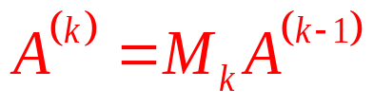
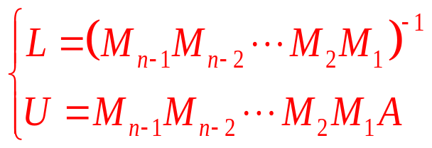

LU factorization (without Pivoting)
Algorithm
For
do
Find an elementary matrix
such that
has zeros below (k,k) entry of the k^{th} column.
End For
Write
and

Slide 22
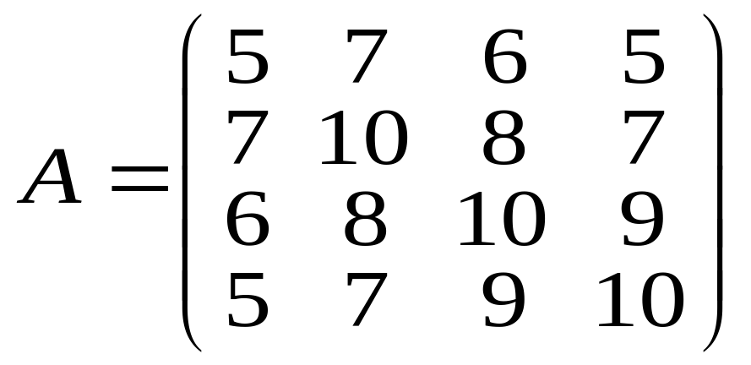
Example
Find the LU factorization of
using Gaussian Elimination without Pivoting.

Slide 23
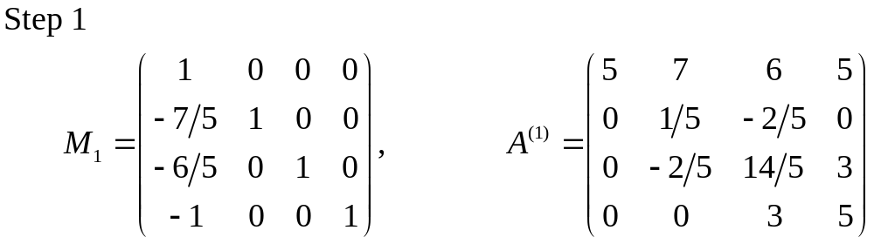
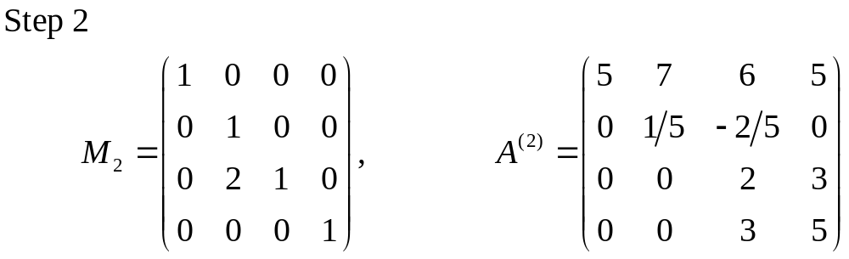
Solution to Example

Slide 24
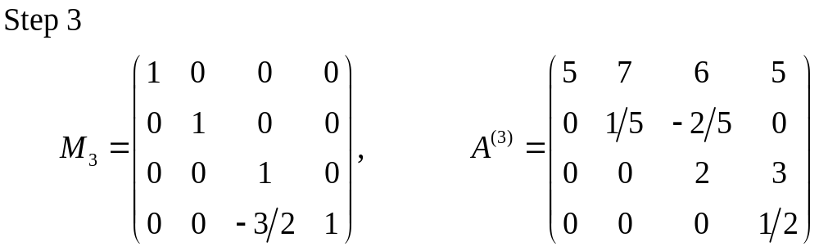
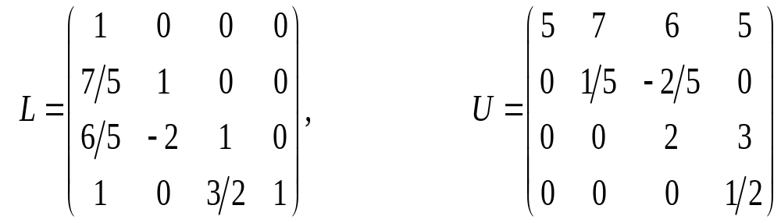
Solution to Example

Slide 25

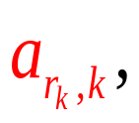

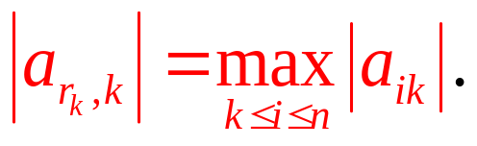

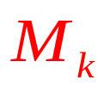
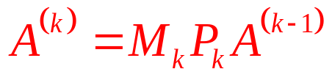

LU factorization (with Partial Pivoting)
Algorithm
For
do
Scan the entries of the k^{th} column of the matrix
below the row
identify the pivot
such that
Form the permutation matrix
and the elementary
matrix
such that
has zeros
below the
entry on the kth column.
End For

Slide 26
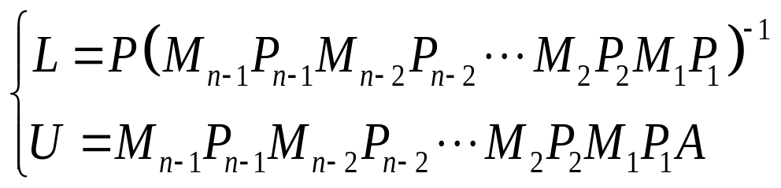
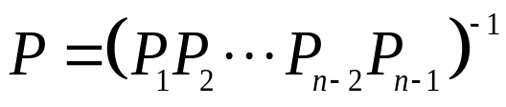

Solution of the System Ax=b
Write
where
and

Slide 27
Example
Find the LU factorization of
using Gaussian Elimination with partial Pivoting.

Slide 28
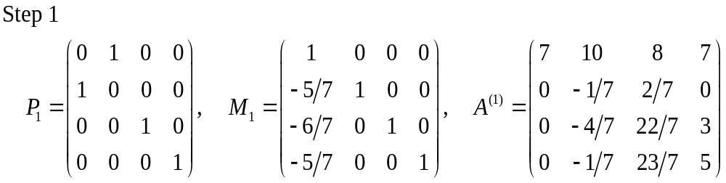
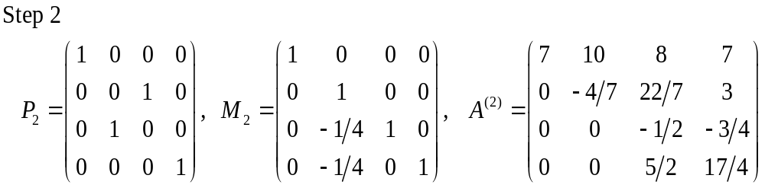
Solution
Solution

Slide 29
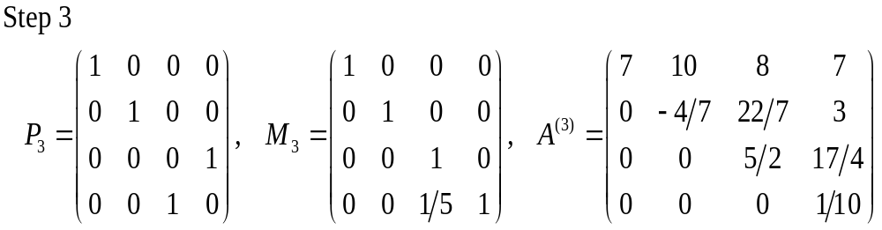
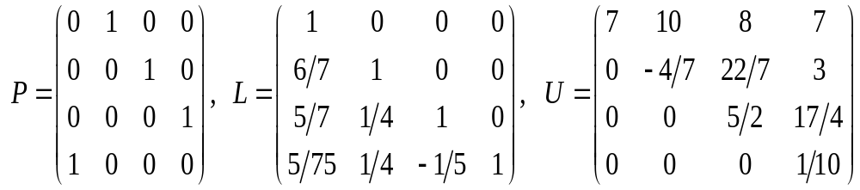
Solution
and

Slide 30


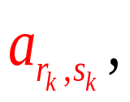
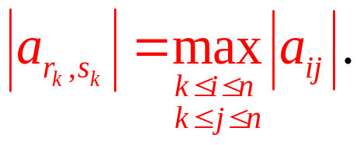


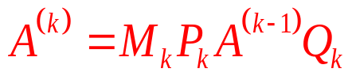

LU factorization (with Complete Pivoting)
Algorithm
For
do
Scan the entries of the
below the row
and
to the right of the column
to identify the pivot
such that
Form the permutation
matrices
and
and the elementary matrix
such that
has zeros below the
entry on the k^{th} column.
End For

Slide 31
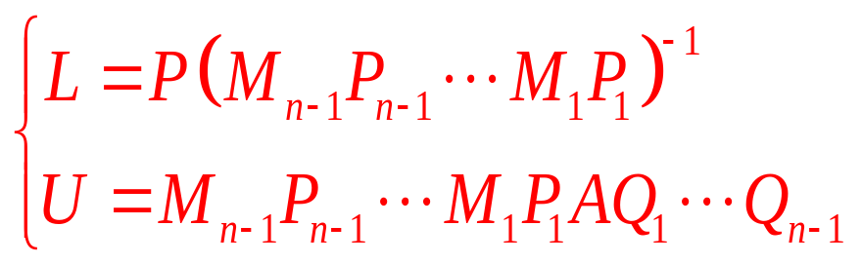
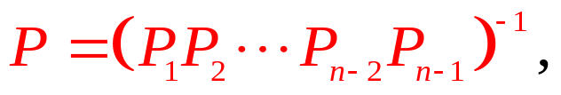


LU factorization (with Complete Pivoting)
Write
where
and

Slide 32
Example
Find the LU factorization of
using Gaussian Elimination with complete Pivoting.

Slide 33
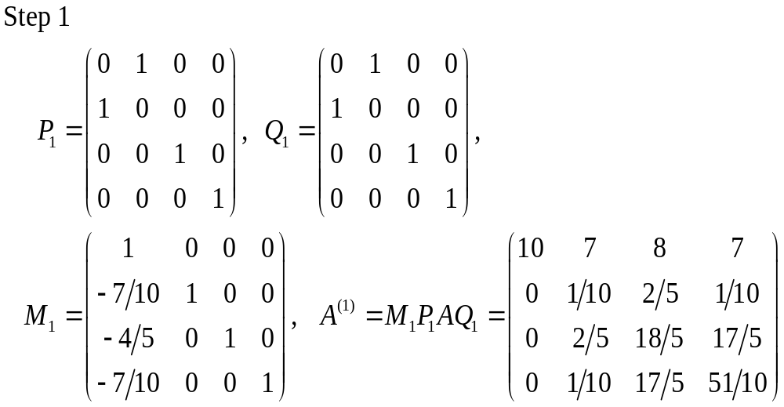
Solution

Slide 34
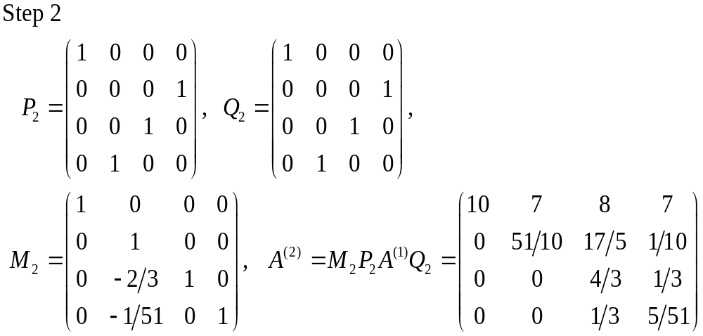
Solution

Slide 35
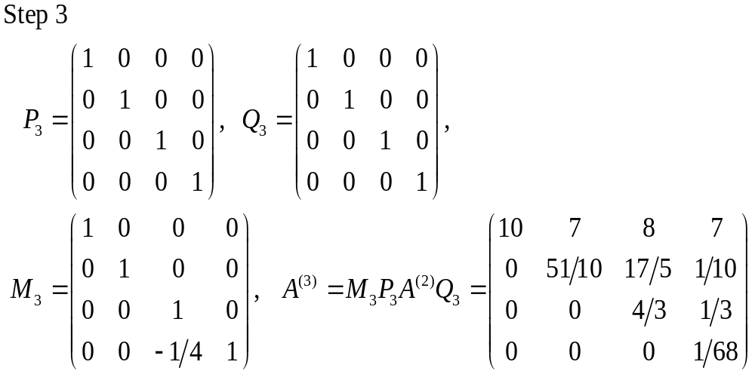
Solution

Slide 36
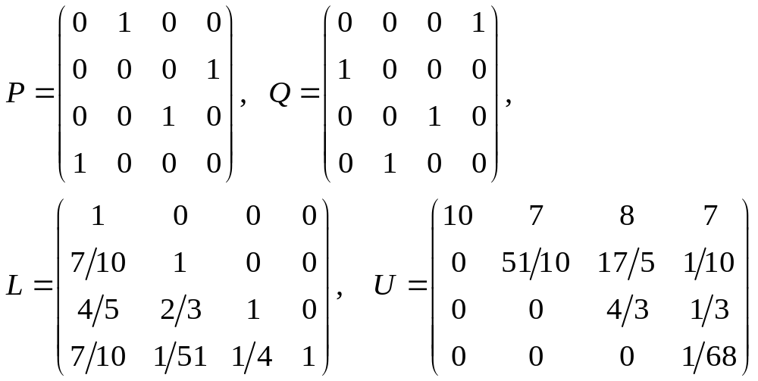
Solution
and

Slide 37
Solution of the System Ax=b
Gaussian Elimination without Pivoting
The solution of the system Ax=b using LU factorization (without pivoting) can be achieved in two stages:
Step 1: Find an LU factorization of A.
Step 2: Solve two triangular systems: the lower triangular system Ly=b first, followed by the upper triangular system Ux=y.

Slide 38


Solution of the System Ax=b
Once we have the factorization of A, the system becomes equivalent to two triangular systems:

Slide 39


Example
Solve the system
using Gaussian elimination
without pivoting, where

Slide 40


Example
We compute LU as follows:

Slide 41



Example

Slide 42



Solution of the System Ax=b
Gaussian Elimination with Partial Pivoting
The solution of the system Ax=b using LU factorization (with partial pivoting) can be achieved in two stages:
Step 1: Find the LU factorization PA=LU.
Step 2: Solve two triangular systems: the lower triangular system first, followed by the upper triangular system where

Slide 43

Solution of the System Ax=b
Once we have the factorization of A, the system becomes equivalent to two triangular systems:

Slide 44

Example
Solve the system using Gaussian elimination with partial pivoting, where

Slide 45


Solution

Slide 46




Solution

Slide 47



Solution of the System Ax=b
Gaussian Elimination with Complete Pivoting
The solution of the system Ax=b using LU factorization (with complete pivoting) can be achieved in two stages:
Step 1: Find the LU factorization PAQ=LU.
Step 2: Solve the two triangular systems: the lower triangular system where first, followed by the upper triangular system and write the solution as

Slide 48
Solution of the System Ax=b
Once we have the factorization of A, the system becomes equivalent to two triangular systems:

Slide 49
Example
Solve the system using Gaussian elimination with complete pivoting, where

Slide 50

Solution

Slide 51

Solution

Slide 52


Solution

Slide 53


Solution

Slide 54

Solution of Ax = b without Explicit Factorization
In this case the solution can be obtained by solving an upper triangular system obtained by processing the matrix A and the vector b simultaneously.
An augmented matrix is formed, and triangularized and the solution is then obtained by back substitution.

Slide 55





Example:
Solve the system
without explicit factorization where A and b
are given as follows:
Solution:
The pivot entry is

Slide 56






Solution:
The pivot entry is
The reduced triangular system
is
The solution is

Slide 57




Example
Solve the system
using Partial Pivoting without Explicit
Factorization where A and b are given as follows:
Solution
The pivot entry is
Interchanged rows 3 and 1 of A and b.

Slide 58





Solution Cont’d
The pivot entry is
The reduced triangular system
is
The solution is

Slide 59



Example
Solve the system
using Complete Pivoting without Explicit
Factorization where A and b are given as follows:
Solution
The pivot entry is
Interchanging rows 3 and 1 of A and b, and columns 2 and 1 of A,
we have

Slide 60




Solution Cont’d
The pivot entry is
No rows interchanges
needed. Interchanging columns 3 and 2 of A, we have
The reduced triangular system
is
The solution is

Slide 61













Vector and Matrix Norms
A vector norm on a vector space X is a real-valued function on X having the following properties:
for all nonzero vectors
for all vectors and scalars
for all vectors and
On
the simplest vector norms are:
where
denotes the i^{th} component of the vector x.

Slide 62





Vector and Matrix Norms
When a vector norm has been specified on
the related matrix
norm for an
matrix A is defined as follows:
This matrix norm is the subordinate norm to the given vector norm or the norm induced by the given vector norm.
On
the simplest matrix norms are:

Slide 63
Vector and Matrix Norms
A vector norm on a vector space X is a real-valued function on X having the following properties:
for all nonzero vectors
for all vectors and scalars
for all vectors and

Slide 64





The Power Method
Let be an approximation to a real eigenvalue such that ;
that is, is much closer to than to the other eigenvalues.
The sequence converges to the direction of the eigenvector corresponding to .

Slide 65

The Inverse Power Method/ Inverse Iteration
Let be an approximation to a real eigenvalue such that ;
that is, is much closer to than to the other eigenvalues.
The sequence converges to the direction of the eigenvector corresponding to .

